Slide 1
Design for Verification Project Update
2021-03-01
Eldrick Millares, Jack Humphries (eldrick, jhumphri@stanford.edu)

Slide 2
Tasks Completed
Vscale CSR Validation
Scheduled call with Shashank (tomorrow)

Slide 3
Tasks In Progress
Proof Sketch Rework
Analysis of ridecore simplifications
Case-studies of interesting processor features (e.g. fast paths)

Slide 4
Appendix
(Courtesy of Florian Lonsing)

Slide 5
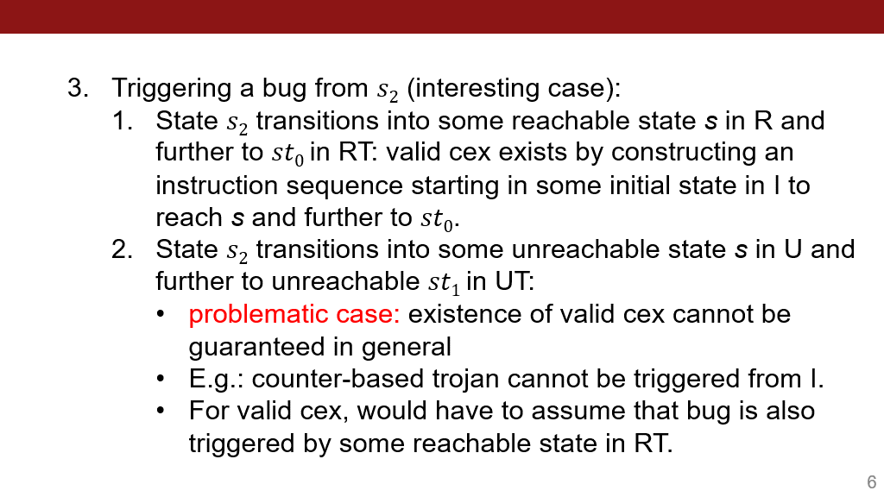

Slide 6
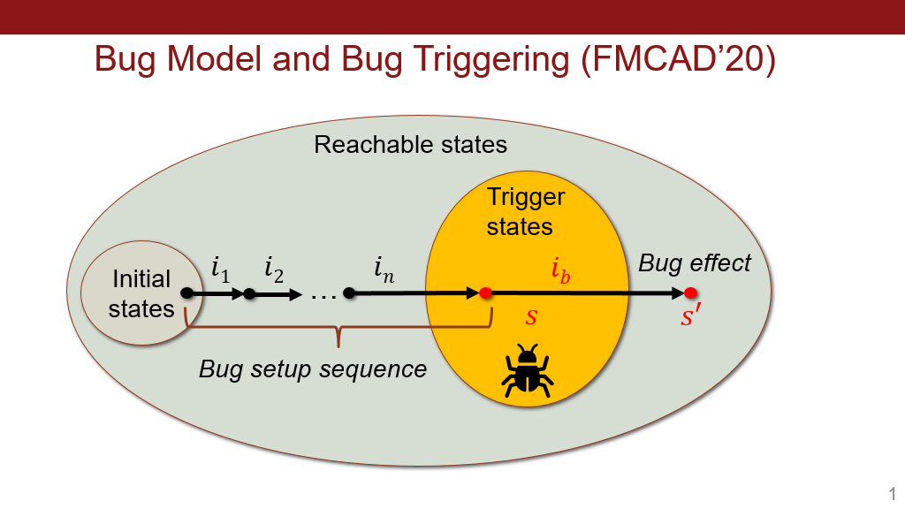

Slide 7
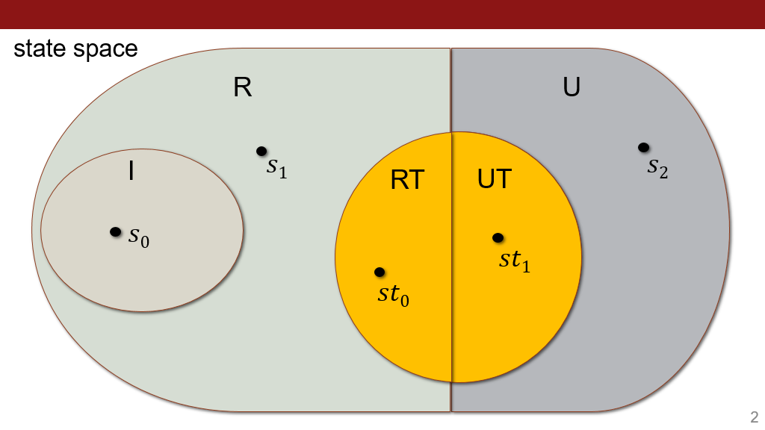

Slide 8
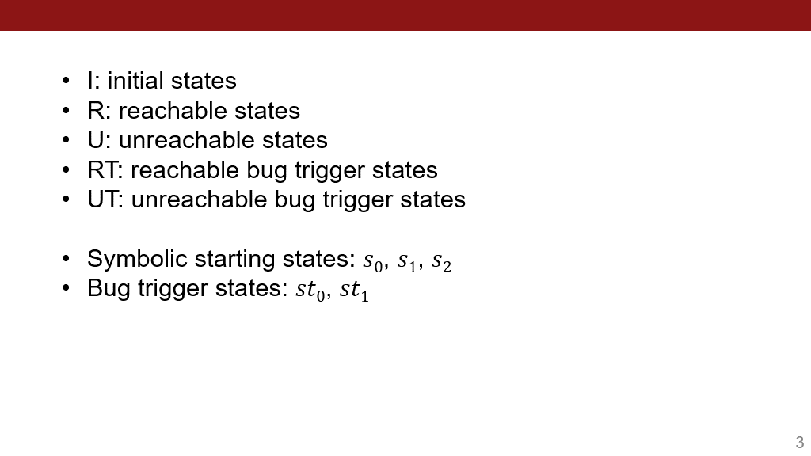

Slide 9
